Slide 1
AN OPEN-SOURCE RRAM COMPILER
BY
SAIPRANAV K – 21BEC1207
SANTHOSH KUMAR S – 21BEC1283

Slide 2
OBJECTIVE:
To design and implement the block which contains Controller, Decoder SEL and Word Column Decoder using VERILOG
To design and implement the Sense Amplifier Circuit with Input Stage using CADENCE VIRTUOSO.

Slide 3
INTRODUCTION:
Resistive Random Access Memory (RRAM) is a type of non-volatile memory that uses memristors in its memory cells.
Memristors are a type of passive electronic component that can "remember" the amount of charge that has flowed through them in the past.
Unlike volatile memories such as dynamic random access memory (DRAM), RRAM does not suffer from high power consumption and loss of data on power off.

Slide 4
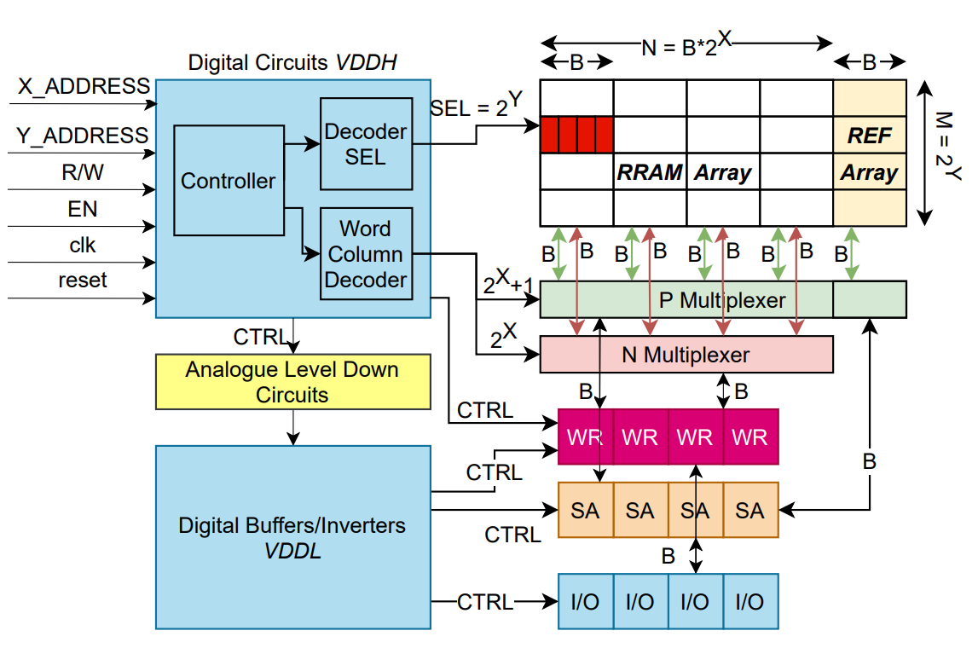
BLOCK DIAGRAM:
Figure shows the simplified block diagram of the RRAM architecture where the size of the RRAM array is M × N

Slide 5
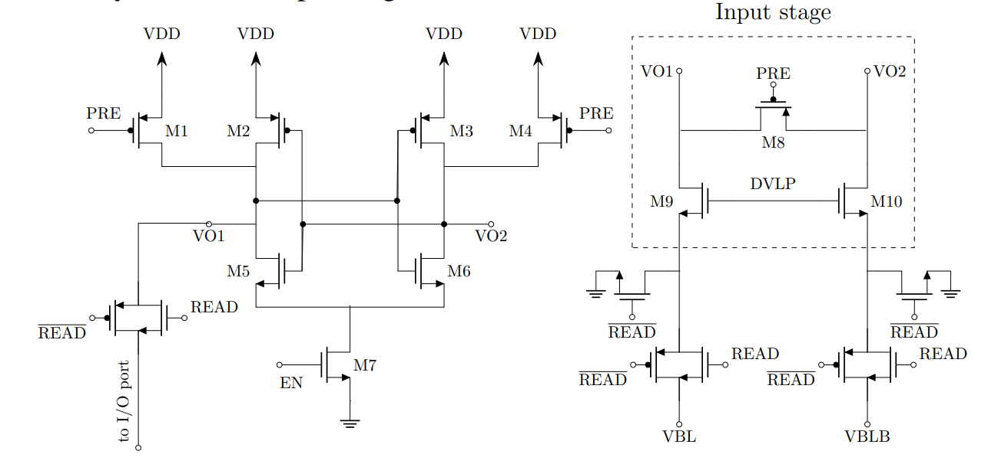
RRAM ARCH. CIRCUIT:

Slide 6
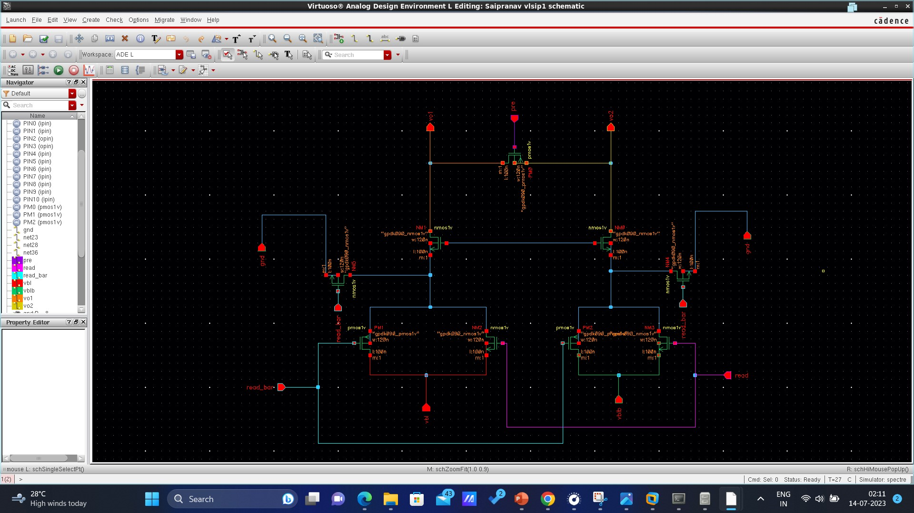

Slide 7
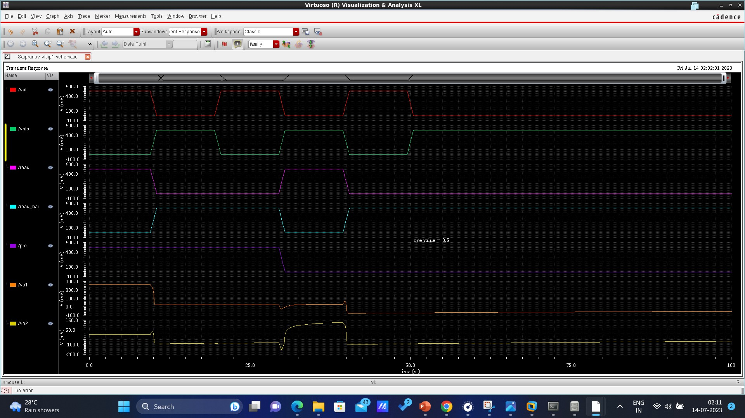

Slide 8
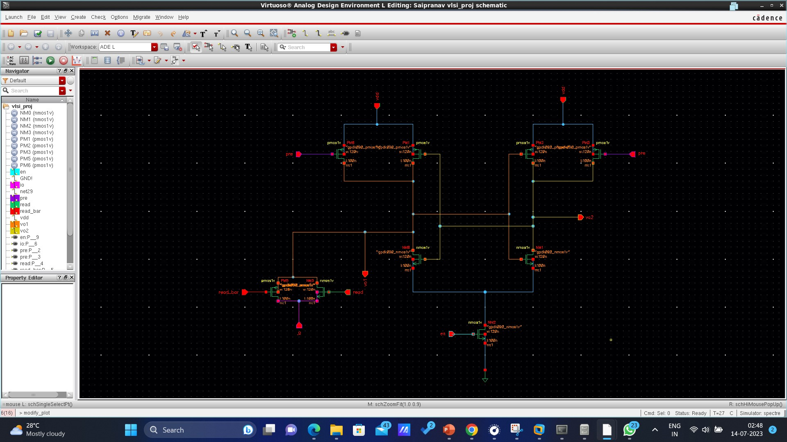

Slide 9
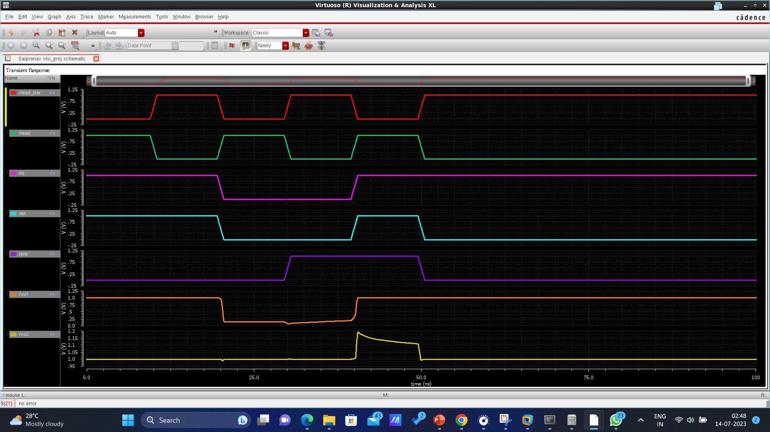

Slide 10
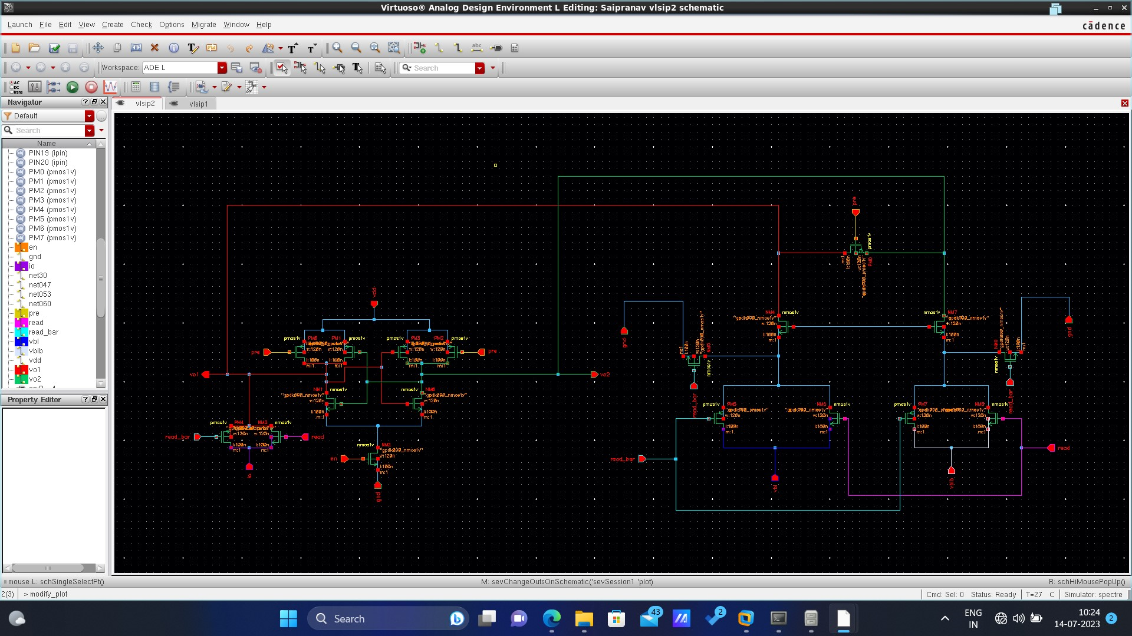

Slide 11
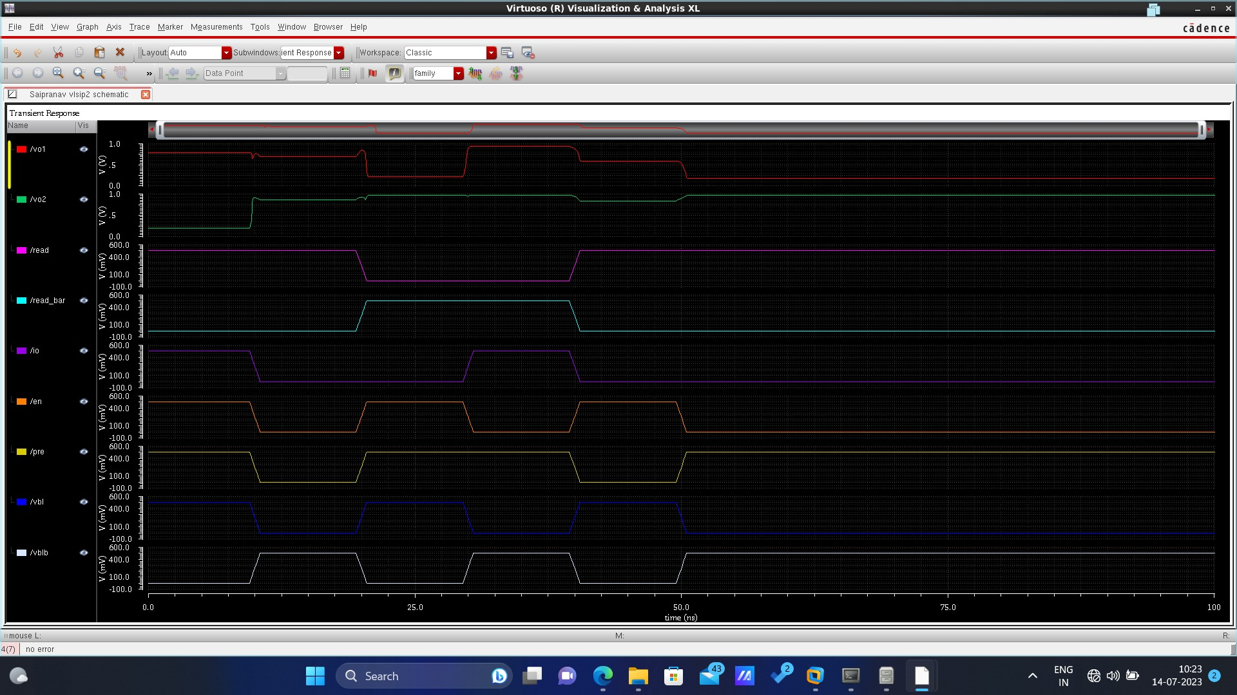

Slide 12
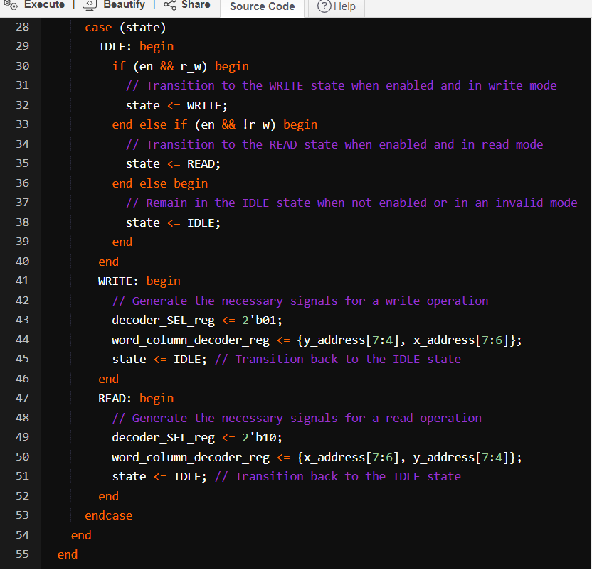
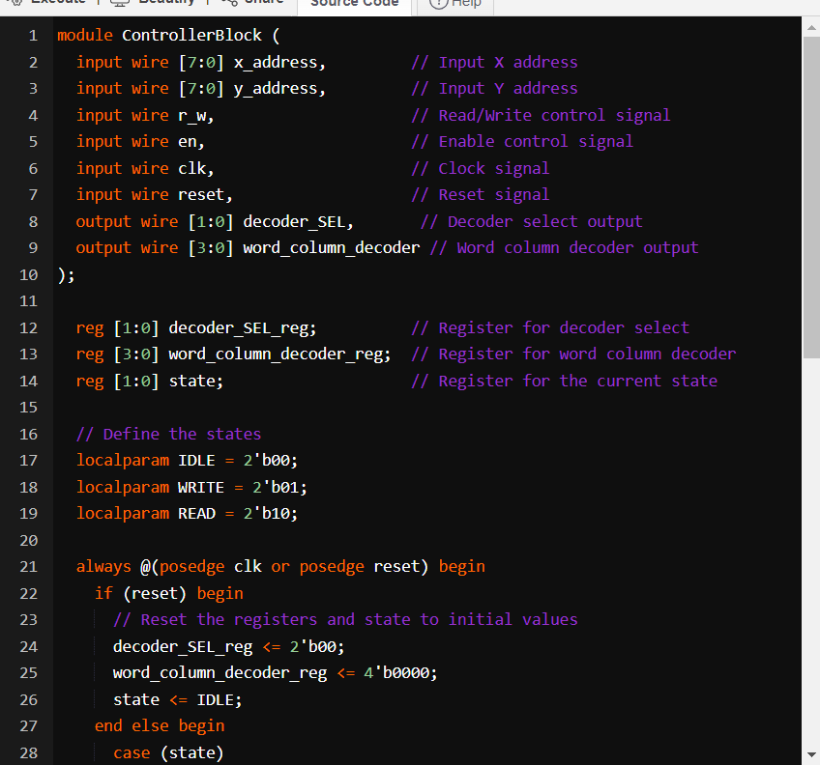
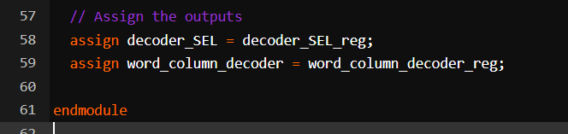
VERILOG IMPLEMENTATION(MAIN CODE):

Slide 13
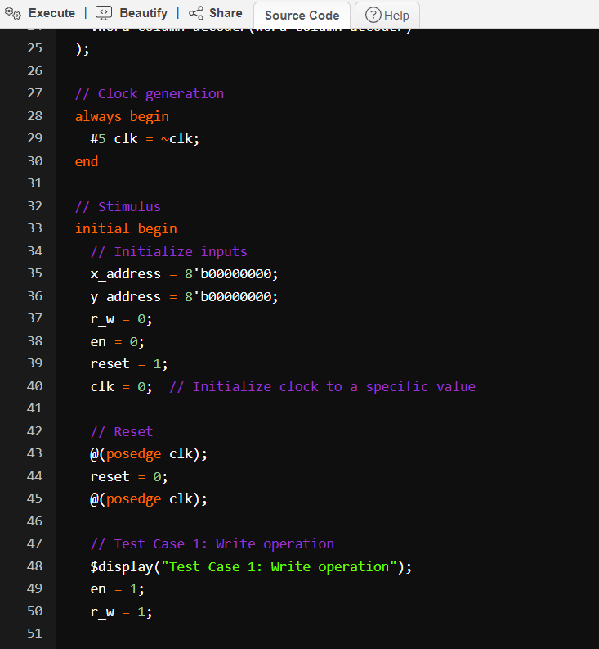
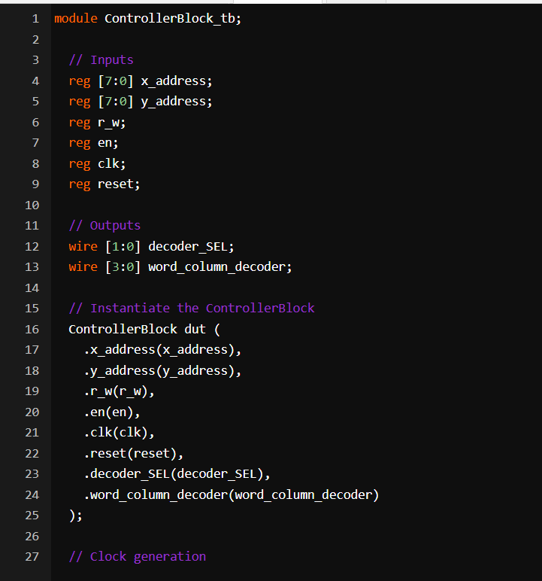
TEST BENCH:

Slide 14
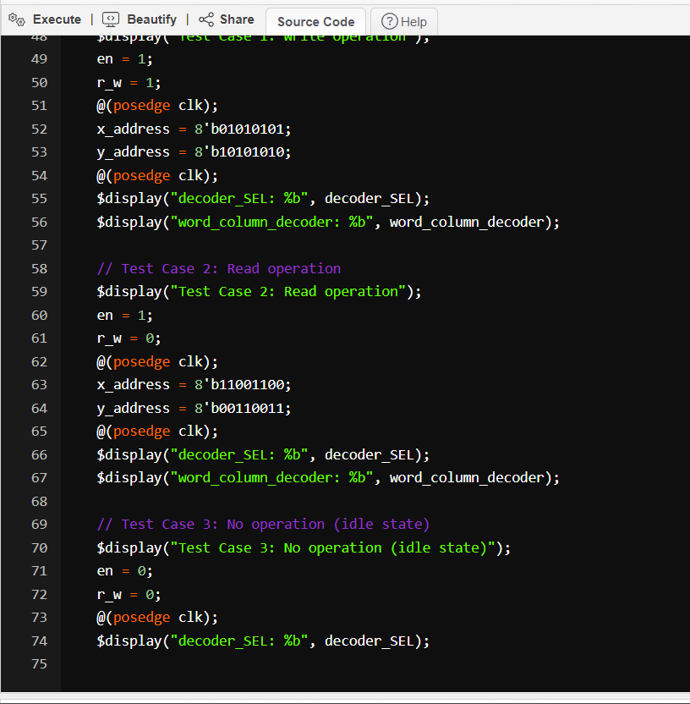
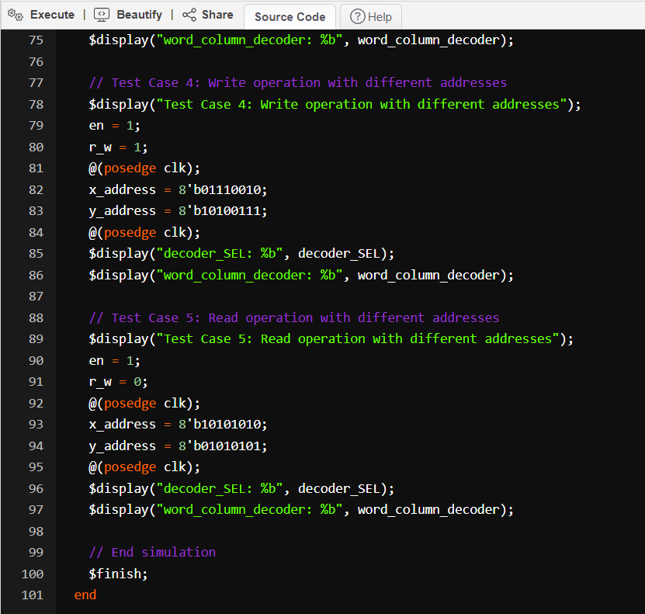

Slide 15
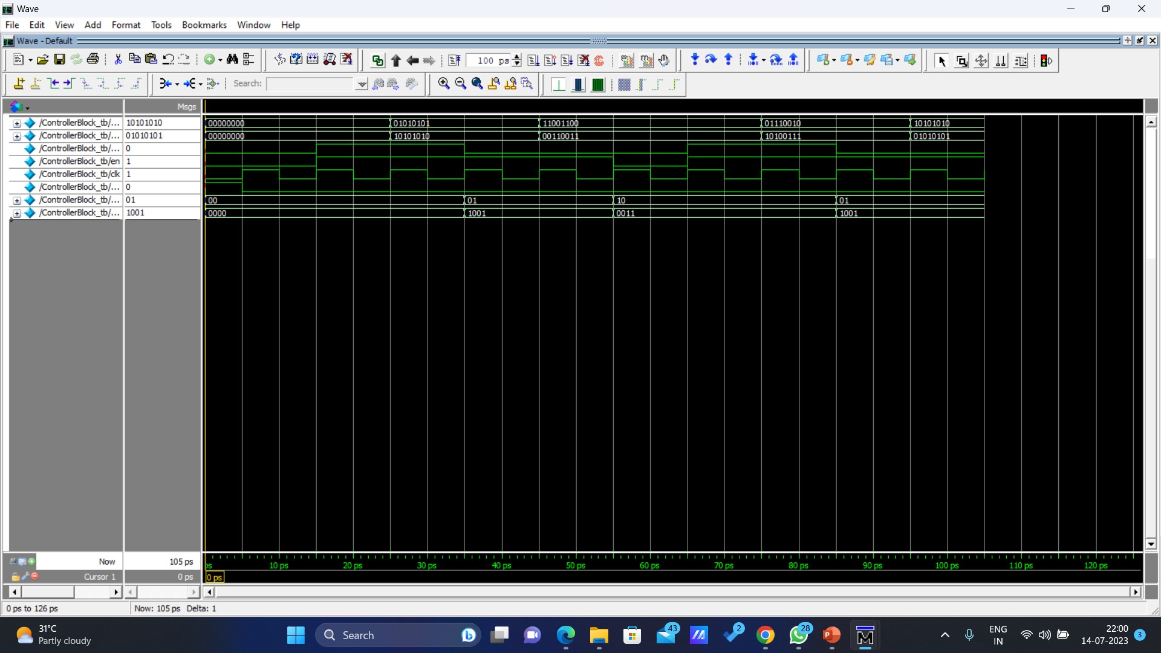
OUTPUT WAVEFORM:

Slide 16


